Slide 1
A Study on Video Data Mining
Authors: R. Vijaykumar, R. NedunCHEZhian Journal : springer presented By: Suman nandi (2k20/swe/23)

Slide 2
Abstract
The objective of video data mining is to discover and describe interesting patterns from the huge amount of video data as it is one of the core problem areas of the data-mining research community.
This paper also lists the applications of data mining.

Slide 3
introduction
The video data consists of three main kinds of things namely video, audio and text.
The video consists of sequence of images with some temporal information.
The audio consists of speech, music and various special sounds.
The textual information represents its linguistic form.

Slide 4
Introduction (cont.)
The video content can be divided into three categories:-
Low level Feature Information: This includes the colour, texture and shape of the video.
Syntactic Information: This describes the content of the video, their spatial-temporal position and spatial temporal relations between them.
Semantic information: This describes what is happening in the video along with what is perceived by the users.

Slide 5
Video processing
One of the key challenges faced is to transform the video data from non-structured data into a structured data set as the processing of the video data with image processing or computer vision techniques demands structured-format features.
There are two main kinds of videos. One is scripted videos which includes a number of retakes and are carefully produced according to the script. Second is unscripted videos like surveillance videos and sports videos which have no scene change.
The most fundamental task in video processing is to partition the long video sequences into a number of shots and find a key frame of each shot for further video information retrieval task.

Slide 6
Video data model
A video data model is a representation of video data based on its characteristics and content as well as the applications it is intended for.
A hierarchical data model is made that captures the structures and semantics of video contents in databases.
It provides a framework for automatic mapping from the high-level concepts to the low-level representative features.
It is exploited by partitioning the video contents into a set of hierarchically manageable units such as clusters, sub clusters, sub regions, shots or objects, frames or video object planes and regions.

Slide 7
Video segmentation
There are two basic kinds of segmentation. One is visual- based segmentation which identifies the shot boundaries and the second one is motion based segmentation which identifies pans and zooms.
Video: It refers to multimedia sequences comprised of both sound and a series of images.
Scene: It is a collection of semantically related and temporally adjacent groups depicting and conveying a high-level concept with a sequence of shots focusing on the same point or location of interest.
Video group: It is an intermediate entity between the physical shots and semantic scenes serving as the bridge between the shot and scene.

Slide 8
Video segmentation
Shot: It is defined as a sequence of frames taken by a single camera with no major changes in the visual content.
Key frame: The frame represents the salient visual contents of a shot. The key frames extracted from the video streams are treated as images.

Slide 9
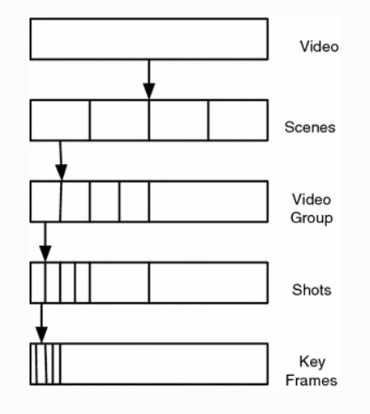
Video hierarchy

Slide 10
Feature extraction
A Feature is defined as a descriptive parameter extracted from an image or a video stream.
There are two kinds of video features extracted from the video. They are:
The Description based features that use metadata, such as keywords, caption, size and time of the creation.
The Content based features are based on the content of the object itself.

Slide 11
Video information retrieval
A video retrieval system is essentially a database management system.
It is for handling video data concerning with returning similar video clips (or scenes, shots, and frames) to a user for their video query.
There are four steps involved in any automatic video information retrieval. They are:
Shot boundary detection
Key frames selection
Extracting low-level features from key frames.
Content-based video information retrieval with a query in the form of input provided by the user.

Slide 12
Video abstraction
Video Abstraction is a short summary of a long video having a set of stills or moving images selected and reconstructed from an original video with concise information about the content widely used in the video cataloging, indexing and retrieving.
The video abstraction is of two types. They are:
Video Summarization: Video Summarization is defined as a sequence of stills or moving pictures (with or without audio) presenting the content of a video in such a way that the respective target group is rapidly provided with concise information about the content preserving the essential message of the original and aiming at generating a series of visual contents for users to browse and understand the whole story of the video efficiently. Foe e.g. : Highlights of a match.

Slide 13
Video abstraction
Dynamic Video Skimming: Video skimming consists of a collection of image sequences along with the related audios from an original video possessing a higher level of semantic meaning or preview of an original video than the video summary does and highlight generation is one of the important applications in it with the most interesting and attractive parts of a video. For e.g. : Trailer of a movie.

Slide 14
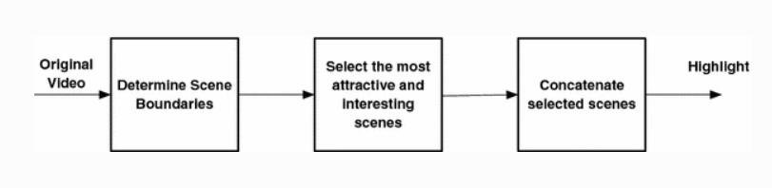
A video highlight

Slide 15
Video data mining
It is video data mining that deals with the extraction of implicit knowledge, video data relationships, or other patterns not explicitly stored in the video databases considered as an extension of still image mining by including mining of temporal image sequences.
It is a process which not only automatically extracts content and structure of video, features of moving objects, spatial or temporal correlations of those features, but also discovers patterns of video structure, object activities, video events from vast amounts of video data with a little assumption of their contents.

Slide 16
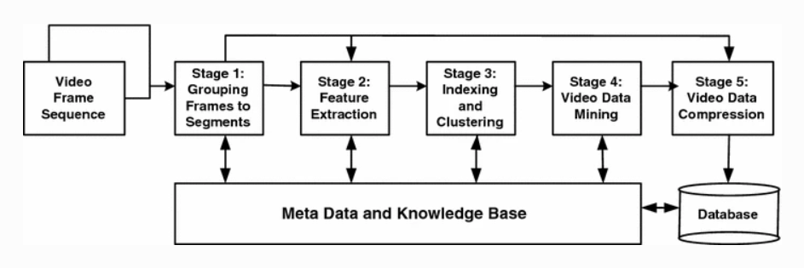
framework for video data mining

Slide 17
Video data mining approaches
Video Structure Mining
Video Clustering And Classification
Video Association Mining
Video Motion Mining
Video Pattern Mining

Slide 18
Video structure mining
Video structure mining is defined as the process of discovering the fundamental logic structure from the preprocessed video program adopting data-mining method such as classification, clustering and association rule.
Video structure mining is executed in the following steps:
(1) Video shot detection
(2) Scene detection
(3) Scene clustering
(4) Event mining.

Slide 19
Video clustering and classification
Video clustering and classification are used to cluster and classify video units into different categories.
Clustering similar shots into one unit eliminates redundancy and as a result, produces a more concise video content summary.
A block diagram of the general problem of video clustering is shown on the next slide. It is detecting by the shots from the video frame sequence that the key frames are extracted.

Slide 20
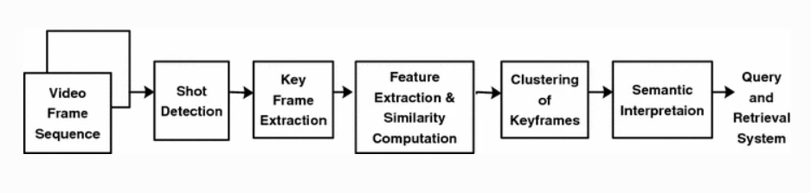
Video clustering

Slide 21
Video classification
Video classification aims at grouping videos together with similar contents and to disjoin videos with non-similar contents and thus categorizing or assigning class labels to a pattern set under the supervision.
Video classifications are based on the spatial and temporal characteristics and necessary for efficient access, understanding and retrieval of the videos.
A video graph tool is proposed for video mining and visualizing the structure of the plot of a video sequence. The video graph of the video clip is the directed graph where every node corresponds to a shot group and edges indicate temporal succession. This algorithm is used to “stitch” together similar scenes even if they are not consecutive and automatically derive video graphs

Slide 22
Video association mining
Video association mining is the process of discovering associations in a given video.
A video semantic discovery framework is developed that utilizes multimodal content analysis and association rule mining technique to discover the semantic concepts from video data.
The framework uses the Apriori algorithm and association rule mining to find the frequent item-sets in the feature data set and generated the classification rules to classify the video shots into different concepts.

Slide 23
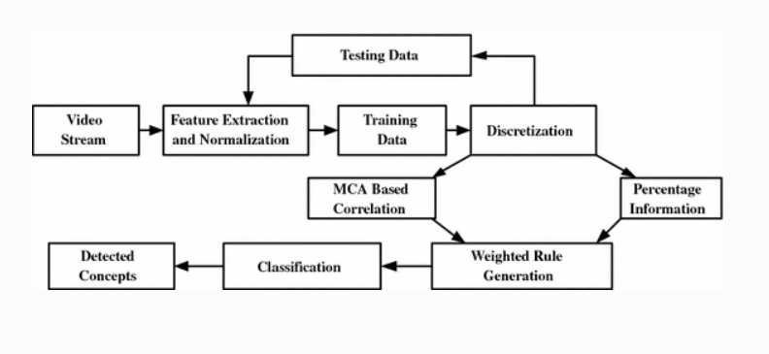
Semantic concept detection

Slide 24
Video motion mining
Motion is a key feature that essentially characterizes the contents of the video, representing the temporal information of videos and more objective and consistent compared to other features such as color, texture and so on.
First, the features are extracted (physical, visual and aural, motion features) using objects detection and tracking algorithms and then the significations of the features, trends of moving object activities and patterns of events are mined by computing association relations and spatial-temporal relations among the features.

Slide 25
Video pattern mining
Video pattern mining detects the special patterns modeled in advance and usually characterized as video events such as dialogue, or presentation events in medical video.
A feature extraction algorithm based on the background estimation and subtraction followed by spatial clustering and multi-object tracking was used to process sequences of video frames into a track set, which encodes the positions, velocities, and the appearances of the various objects as the function of time are mined to answer the user-generated queries.

Slide 26
Applications: produced video data mining
A produced video is meticulously produced according to a script or plan that is later edited, compiled and distributed for consumption.
News videos, dramas, and movies are examples of the produced video.
The film classification method consists of three steps.

Slide 27
produced video data mining
The first step is Boundary Detection. They analyze the color, motion and brightness from every shot.
The second step is Feature Extraction. In this step they represent the shot with low level features.
The third step is the Classification Process like classification tree, mean shift etc.

Slide 28
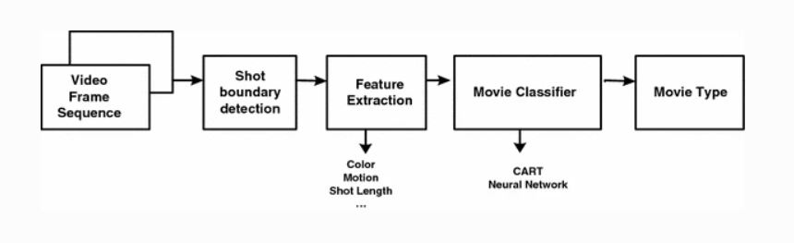
Movie classification

Slide 29
Raw video data mining
There are two common types of surveillance video used in the real world applications such as the security video generally used for property or public areas and the monitoring video used to monitor the traffic flow.
The surveillance systems with data-mining techniques are investigated to find out suspicious people capable of indulging in abnormal activities. However, the captured video data are commonly stored or previewed by operators to find abnormal moving objects or events.

Slide 30
Surveillance videos
A framework is proposed to discriminate between normal and abnormal event in a surveillance video. In the framework, the audio-visual features are extracted from the incoming data stream and the resultant real valued feature data is binarized.
A feature selection process based on association rule mining has selected highly discriminant features.
A short representative signature of the whole database is generated using a novel reservoir sampling algorithm stored in binary form and used with a Support Vector Classifier to help discriminate events as normal or abnormal event.

Slide 31
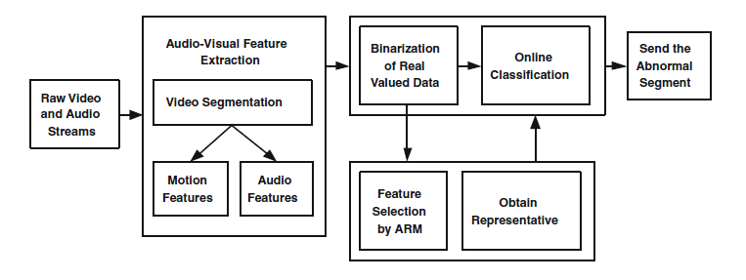
Abnormal detection in surveillance video

Slide 32
Detection of suspicious activity
A method is proposed to detect suspicious activities such as object exchange, entry of new person, peeping into other’s answer sheet and person exchange from the video captured by a surveillance camera during examinations based on the face and hand recognition.
This is done using image processing and computer vision.

Slide 33
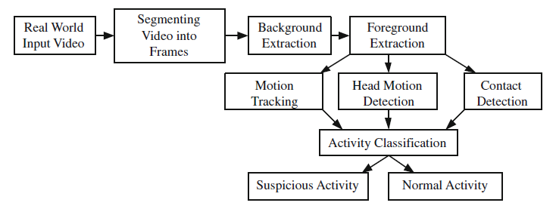
Human activity recognition system

Slide 34
conclusion
In this paper, a brief overview of video data mining is presented. To improve the results of the video datamining, the new features can be constructed by analyzing the heterogeneous data like video text, audio, and videos.
There is no meaningful clustering or segmentation method that can be universally applied to all kinds of visual media.
In-depth research is still required on several critical issues so that there can be developments in leaps and bounds in the data-mining field.

